Slide 1
MAM01 – Workshop: Application Cloud Modernization and Migration
Monday Dec. 3rd
Session 01

Slide 2
Agenda
Terms
Goals & Non-Goals
Why do it?
Measuring Success
Application & Portfolio Analysis Process
M+M To Where?

Slide 3
Migration
Moving an application system from one platform or data-center (DC) to another (including the cloud)
The move in the 90s to go from physical servers to virtual ones, is an example
Moving from the DC to the cloud is another

Slide 4
Migration: Goals and Non-Goals
Goals
Become more 12-Factor
Runs in new environment
Minimal system changes
Non-Goals
Rewrite the app
Rearchitect the app

Slide 5
Modernization
Updating a software system
to a current (vendor or community) supported platform
to adopt more modern patterns and practices, such as breaking up monoliths into microservices
Improving the "abilities" of a system (security, durability, scalability, etc.)

Slide 6
Modernization: Goals and Non-Goals
Goals
Full 12-Factor implementation
No Monoliths
No Singletons
More operable
Non-Goals
New functionality

Slide 7
Lemma: In truth, almost any migration will have elements of modernization if only to allow the bits to run on the new platform

Slide 8
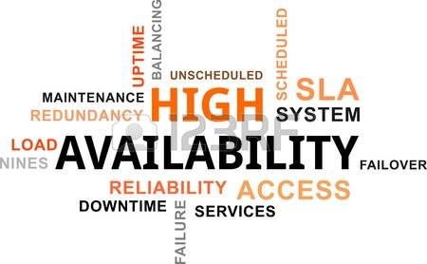
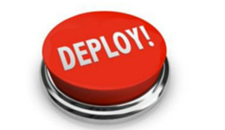
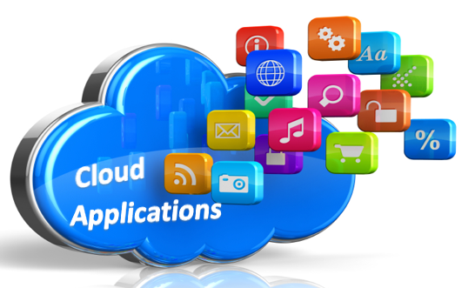
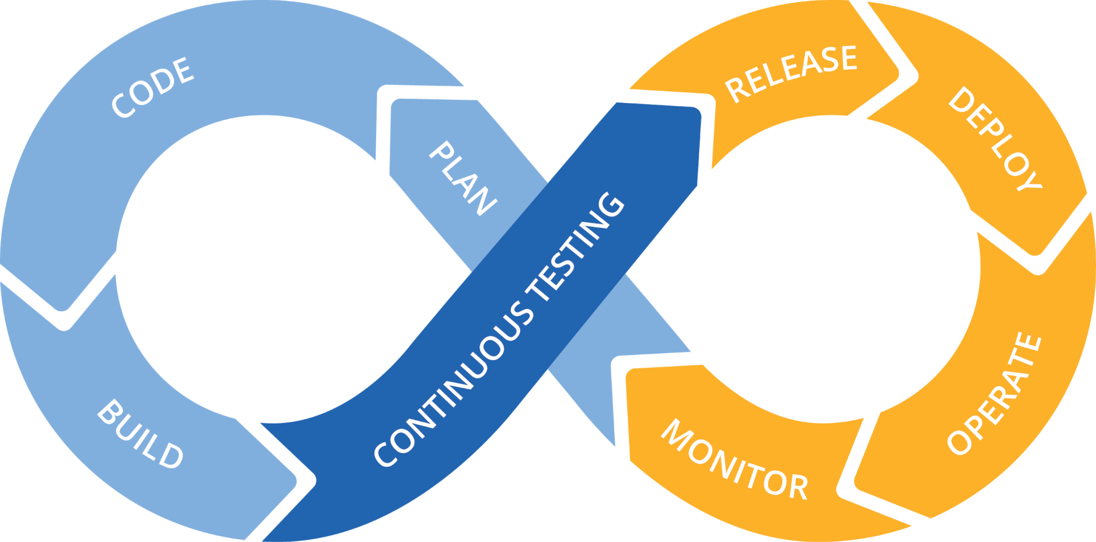
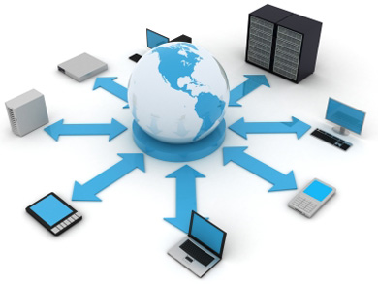

Why do it?
More Business Uptime
Faster Time To Market
Incidents are infrequent vs a regular occurrence. Stable/unified platform!
New product releases will occur more frequently, be automated and require no down-time to deploy or roll-back
Self-Service Environments and Streamlined DevOps support
Scalability & Cost Savings
Compute power will dynamically scale up/down when usage is high/low and we will only be charged for what is used
Product dev teams will use self-service to automatically spin up new environments for QA and testing when needed
Better Security
Rapid resource provisioning
Servers, Networks, Disc volumes, Databases, etc.
Products and services will be highly secured with more effective InfoSec controls along with continuous automated Pivotal repaving

Slide 9
M+M Success Criteria
The application system
continues to fulfill it's business requirements
abilities remain the same or ideally improve
adopts a more scalable and durable enterprise architecture
is more operable
costs less per transaction

Slide 10
Application analysis Process
How to figure out what to do?

Slide 11
Portfolio Rationalization
Inventory
Analyze
Catalog
Backlog
All applications
Ancillary services
All data sources
Diagram the system
Determine if the app is still used
Determine its business value
Determine suitability for the cloud (SNAP)
Decompose functionality
Catalog the functionality of each application
Identifying functionality that crosses apps
Backlog based on app inventory and functionality catalog
Organize based on deprecation or modernizations

Slide 12
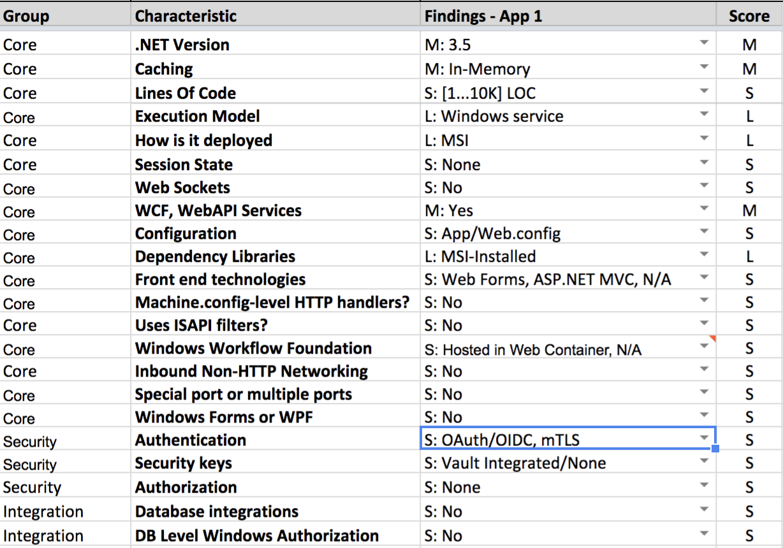
SNAP
Conversational approach of evaluating the suitability of moving an app to the cloud.
Flush out risks
Outline priorities
General understand of the technologies used
Understand relative sizing

Slide 13
Decomposition
Event storming (Pioneered by: Alberto Brandolini)
Workshop method used to understand domains in a system
People
Business: those who understand events in business process
Technical: those who understand where the bodies are buried

Slide 14
Event Storming
Seat Requested
Order Drinks
Queue Order
Ring Bell
Present Bill
Customer aParty Size and Name Recorded
Drinks Ordered
Order Queued
Food Served
Bill Presented
Stickies
- Orange: Events
- Blue: Commands
- Yellow: Aggregates
- Purple: trouble spots
Customer Seated
Drinks Served
Food Cooked
Food Eaten
Pay Bill
What do we do if no seats are available?
Food Ordered
Food Staged
Bill Paid
What do we do if payment is declined?

Slide 15
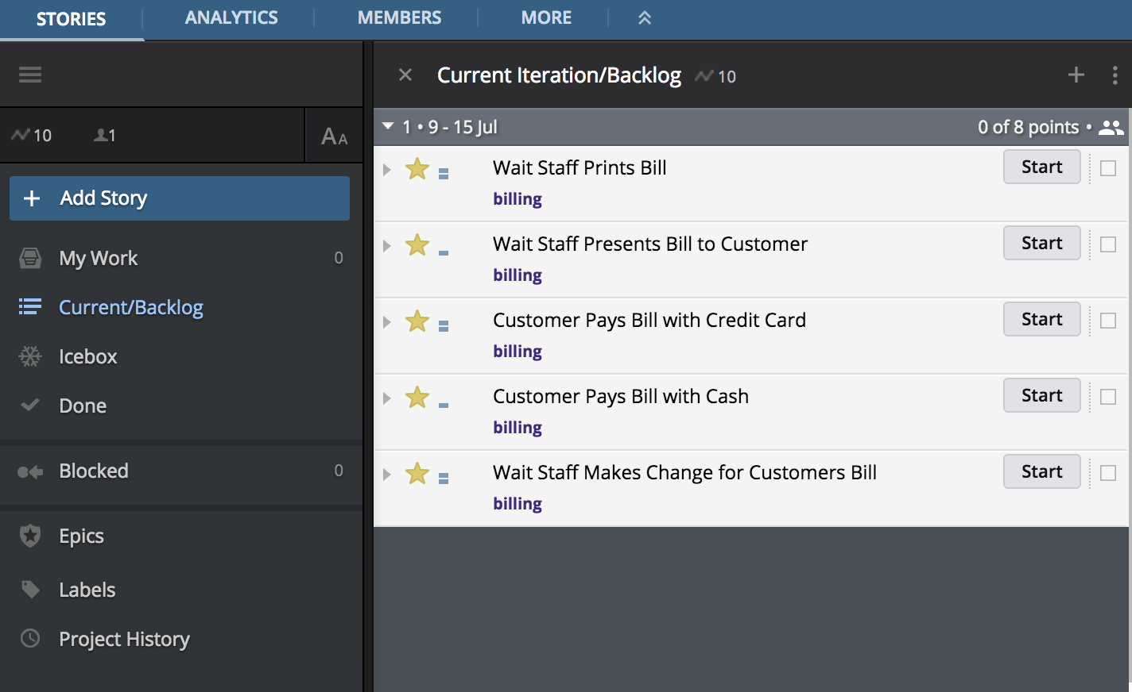
Event Storming
Present Bill
Bill Presented
Pay Bill
Bill Paid
What do we do if payment is declined?

Slide 16
Cataloging
Identifying and catalog functionality for each application
On such platforms like Confluence or Tettra
Evaluate proposed efforts against any existing functionality
Consider centralizing functionality if possible that crosses applications
Update the catalog frequently

Slide 17
Capturing Topology
Identify all deployable units
Something is a deployable unit if code/script executes at it, and it's instance is unique
Web Site, WebService, DB, Queue, Storage are all examples
Develop a plan for each deployable unit
The approach can vary depending on the type of deployable unit

Slide 18
M+M To Where?
Where to put it?

Slide 19
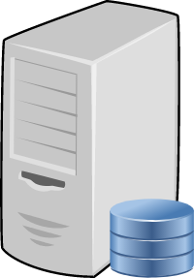
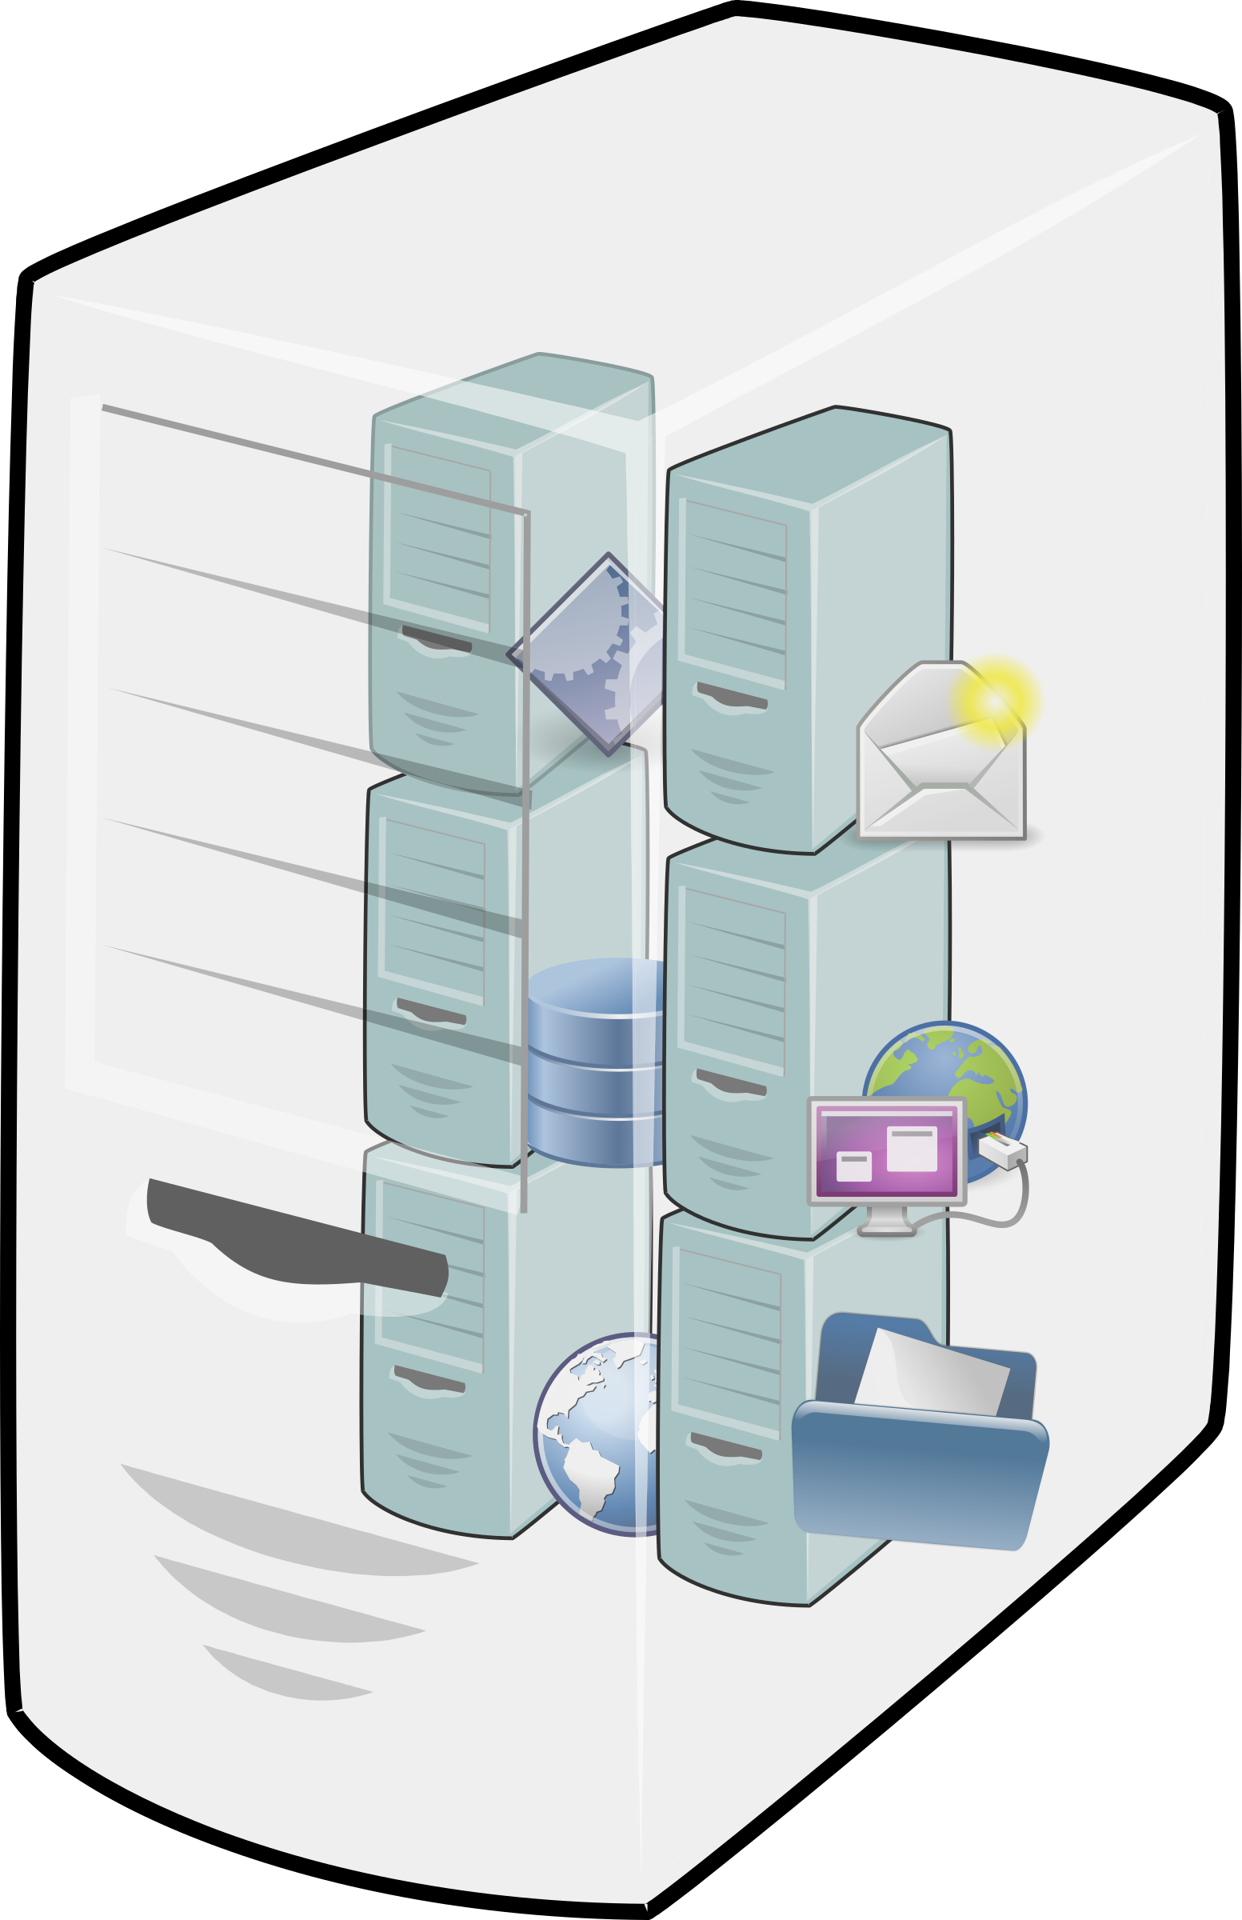
M+M Alternatives
From
To
Physical
Virtual
Container
PaaS
Hardware upgrade
P2V
P2C
P2P
In general starting from a physical server is difficult. Matching the performance can be challenging w/o re-architecture.
Physical
Rare, unless specialize HW
V2V or VM Platform Upgrade
V2C
V2P
This is the most typical scenario. Most orgs have adopted the "utility computing" model e.g. VMs.
Virtual
Container
C2C
C2P (rare)
Once an organization is on containers, generally there are few benefits to changing (other than $$)
There is some benefit here, especially in P2C, but generally PaaS is a good place for systems.
PaaS
P2C
P2P

Slide 20

Lemma: In general the most successful M+M projects use containers for workloads, and PaaS for persistence.
The last time you saw the app, was it still on fire?

Slide 21
Next: Technology Team Concerns

Slide 22


Stuart Williams
Cloud/DevOps Practice Lead + National Markets Consultant
Magenic Technologies Inc.
Email: stuartw@magenic.com
Blog: http://blitzkriegsoftware.net/Blog
LinkedIn: http://lnkd.in/P35kVT
GitHub: https://github.com/BlitzkriegSoftware/MAL2018
YouTube: https://www.youtube.com/channel/UCO88zFRJMTrAZZbYzhvAlMg

